Slide 1
Nifty50 forecasting and trading strategies
Barbieri Claudio, Delera Giacomo, Huser Cyril, Howe Alessandro
Econometrics project 2024/2025
Lecturer: Azzone Michele
TA: Sala Edoardo

Slide 2
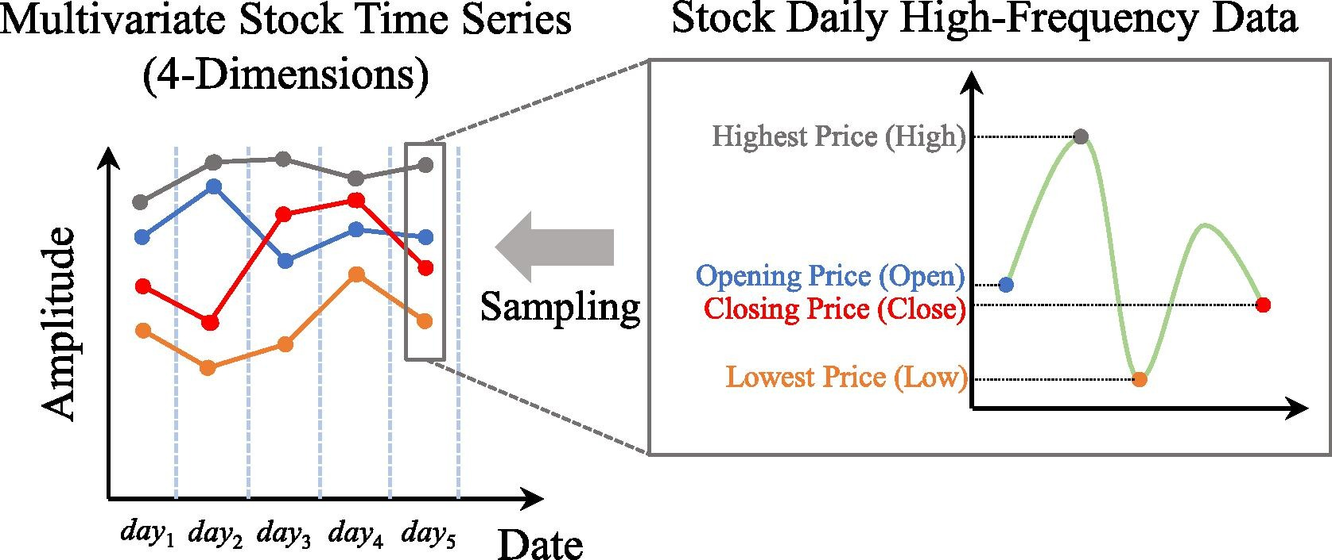
Data 1
OHLCV minute data of Nifty50 processed in daily

Slide 3
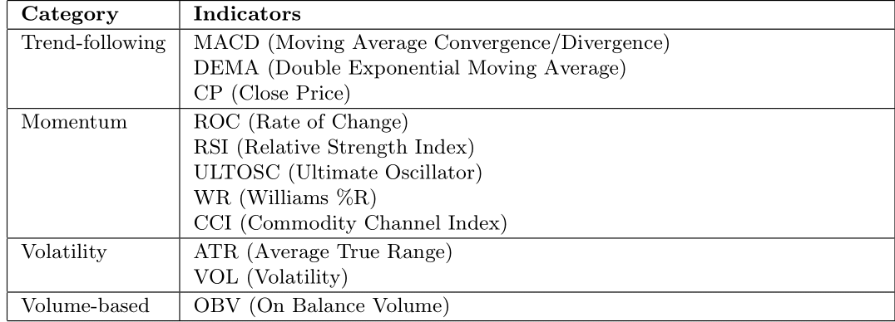
Data 2
Technical indicators and volume extracted from underlying stock

Slide 4
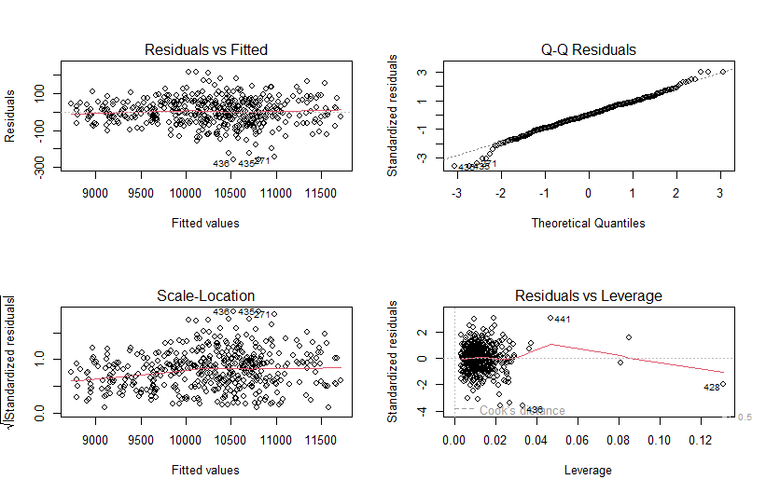
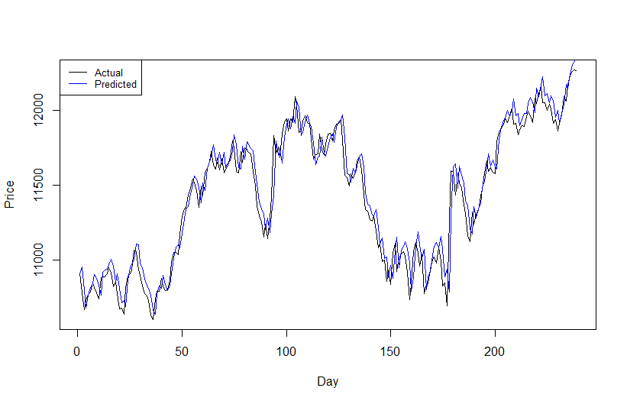
Linear Model
No assumption check as ML literature
CLOSEt+1 = α1 + CLOSEt + ULTISCt + ATRt + OBVt + WRt
Coeff values…..
R2 0.9881
p-value = 0.4736
p-value < 0.01
p-value < 0.01 106.6839

Slide 5
Trading strategies
Different strategies/ selected strategy
Different targeting intraday-whole day
Result

Slide 6
LSTM
Literature inspired
Implementation
Result (with and without SP500?)

Slide 7
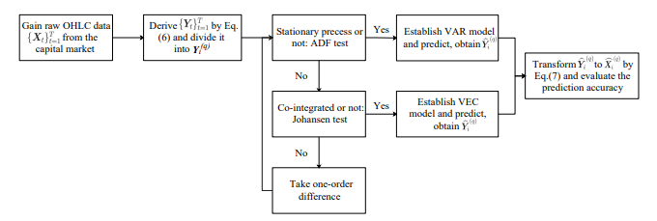
VAR on OHLC
1: Get the raw candlestick charts with T periods from the capital market; 2: Extract the four-dimensional time series data of the candlestick charts, record as {Xt} T t=1; 3: Conduct transformation method to {Xt} T t=1 and obtain {Yt} T t=1 according to Eq.(8); 4: Model {Yt} T t=1 via prediction models to get forecasted future values Ybt ; 5: Conduct inverse transformation method to Ybt according to Eq.(9) and the original forecaster of OHLC data Xct can be derived
-----------------------------------------------------------------------------------------------------
1: Divide {Yt} T t=1 into segments Y (q) i , each segment involves q periods, and each segment rolls forward by one period; 2: Conduct ADF test on the four-dimensional time series data in Y (q) i . If they are all stationary processes, proceed to Step 5, otherwise proceed to Step 3; 3: Use Johansen method to perform the co-integration test on Y (q) i , and determine r. If there is a co-integration relationship, proceed to Step 6, otherwise go to Step 4; 4: Take one-order difference on non-stationary time series in Y (q) i , and then proceed back to Step 2. The optimal situation is iterating until Y (q) i can be modelled by VAR in Eq.(11) or VEC model in Eq.(14). After establishing the VAR or VEC model, the data is then restored back to the corresponding values before the difference. 5: Model Y (q) i with VAR model and predict p periods forwards to obtain Ybi (q) . Conduct inverse transformation method on Ybi (q) to obtain Xci (q) , evaluate the prediction accuracy and end. 6: Model Y (q) i with VEC model and predict p periods forwards to obtain Ybi (q) . Conduct inverse transformation method on Ybi (q) to obtain Xci (q) , evaluate the prediction accuracy and end.
Data transformation
Pseudo algorithm / schema on how it works
Results

Slide 8
GARCH
Ilustration
New modeling paradigm

Slide 9
Probabilistic trading strategy
New trading strategy
Performance

Slide 10
Wrap up conclusive results

Slide 11
References

Slide 12
???
Mettere multi giorno?
Mettere SP500?
Mettere trading strategy subito e poi tutti i modelli o tutti I modello e poi raggrupare risultati alla fine?

Slide 13
Thank you for the attention!

